Slide 1
Memory
Anoosha Rehan, Lecturer, FAST NUCES CFD

Slide 2



Slide 3
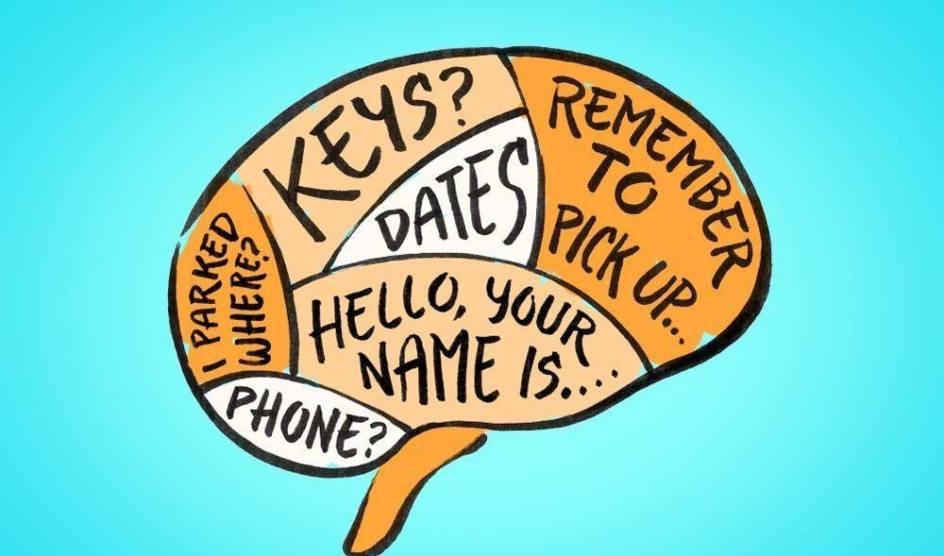
Memory
The ability to retain knowledge.
The process by which we encode, store, and retrieve information.
Information Processing
A continuum including attention, sensation, perception, learning, memory and cognition.

Slide 4
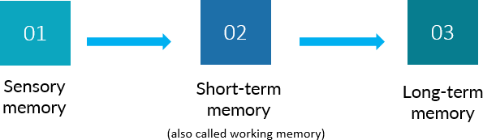
Three stages of memory
Three memory stores that differ in function, capacity and duration are:

Slide 5

1. Sensory Memory
The first stage of A-S (Atkinson-Shiffrin) model that holds large amounts of incoming data for very brief amounts of time.
The initial, momentary storage of information, lasting only an instant.

Slide 6
1. Sensory Memory
Function: process for basic physical characteristics
Capacity: large
can hold many items at once
Duration: very brief retention of images
3 sec for visual info
2 sec for auditory info
Divided into two types:
iconic memory–visual information (turning off a flashlight)
echoic memory– auditory information (car honk)
Attention is needed to transfer information to working memory
Sensory
Sensory Memory
Input

Slide 7
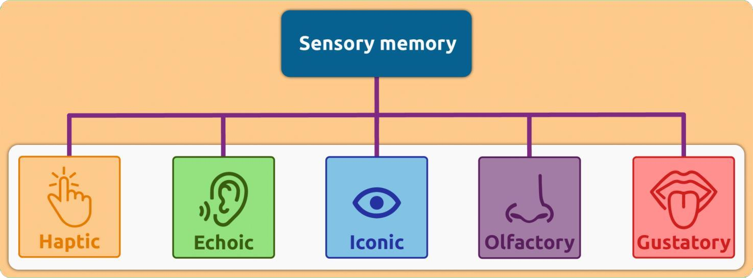
1. Sensory Memory
Visual sensory memory brief memory of an image or icon. Also called iconic memory.
Auditory sensory memory brief memory of a sound or echo. Also called echoic memory.

Slide 8

2. Short-Term Memory (STM) /(Working Memory)
The second stage of A-S model that holds a small amount of information for a limited time.
Memory that holds information for 15-25 seconds called STM.

Slide 9
2. Short-Term Memory (STM) /(Working Memory)
Function: conscious processing of information where information is actively worked on
Capacity: limited (holds 7+/-2 items)
Duration: brief storage (about 25 Sec)
Sensory Memory
Working or Short-term Memory

Slide 10
When you rehearse a phone number in your mind just long enough to dial it, you are using your short-term memory to temporarily hold and process the number.
Remembering a short shopping list before writing it down.

Slide 11
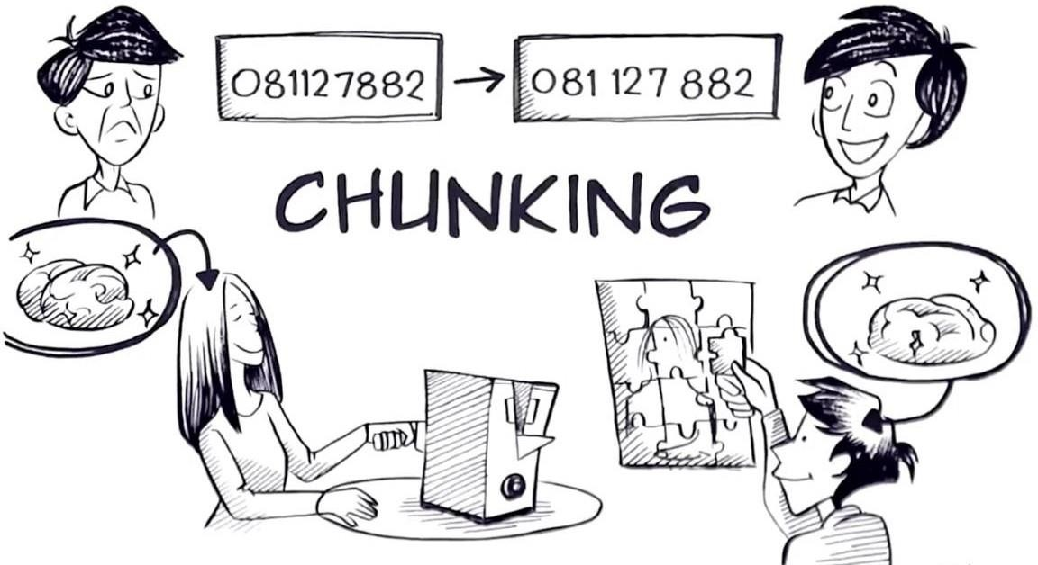
Chunking
A meaningful grouping of stimuli that can be stored as a unit in Short Term Memory.
The process of grouping similar or meaningful information together.
Chunks expand working memory load.

Slide 12
Activity
Which is easier to remember?
P B S F O X C N N A B C C B S M T V N B C
PBS FOX CNN ABC CBS MTV NBC
t h e o c e a n i s b l u e a n d b e a u t i f u l
The ocean is blue and beautiful

Slide 13
When you leave the house, you might think of the group of items you need to bring--phone, wallet, keys, jacket--and thinking of them together helps you remember each.
Credit card numbers. They're always shown in groups of four (e.g., 5555 5555 5555 5555).
Paired items. Knife and fork, earrings and necklace, phone and charger--if you remember one, you're likely to remember the other.

Slide 14

3. Long-Term Memory (LTM)
The final stage of the A-S Model that is the location of permanent memory.
Memory that stores information on a relatively permanent basis, although it may be difficult to retrieve.
Your ability to remember your childhood home, your first day of school, or the lyrics to your favorite childhood song demonstrates the power of long-term memory, as these memories can last for many years.

Slide 15
3. Long-Term Memory (LTM)
Once information passes from sensory to working memory, it can be encoded into long-term memory.
Function—LTM
organizes and stores information
more passive form of storage than working memory
Capacity: Unlimited
Duration: Relatively permanent

Slide 16
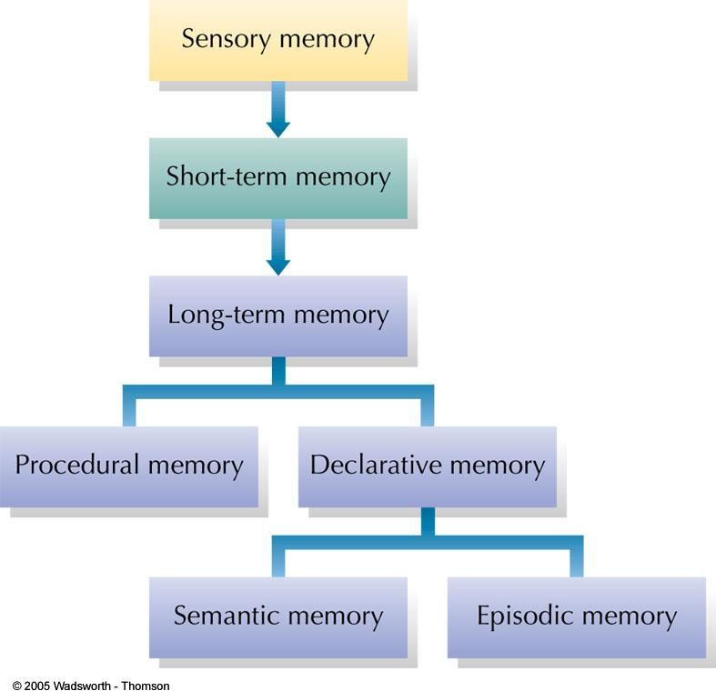
Classification Model of Memory
In the model shown here, long- term memory is divided into procedural memory also known as Non-Declarative Memory, implicit (learned actions and skills)
Declarative memories (Explicit memory), (stored facts). Can be either semantic (impersonal knowledge) or episodic (personal experiences associated with specific times and places).

Slide 17
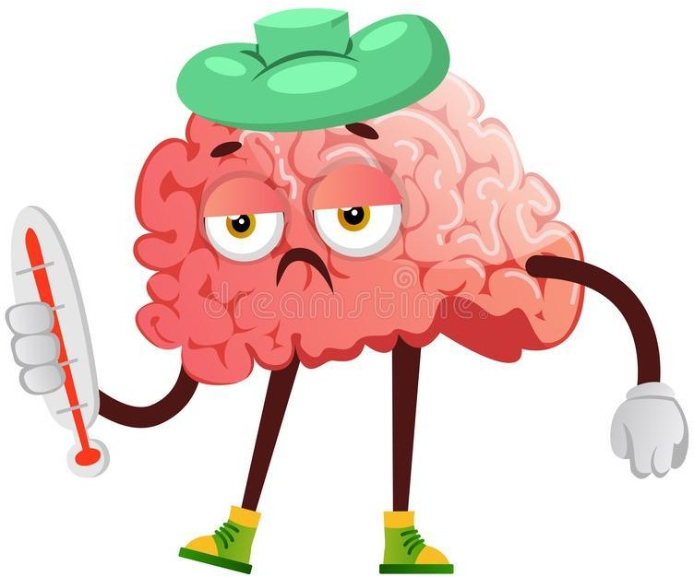
Declarative Memory (Explicit memory)
Information based on facts.
Memory consciously recalled or declared.
Can use explicit memory to directly respond to a question.
Two subtypes of declarative memory:
Semantic memory
Episodic memory

Slide 18

i. Semantic Memory (General memory)
Information about impersonal facts and general knowledge
e.g., North is cold and beautiful.
Memory not tied to personal events.
General facts and definitions about the world.
Examples:
Usually, a car has four wheels.
Color of strawberry is red and it’s useful for health.

Slide 19
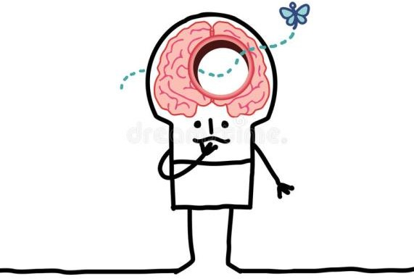
ii. Episodic Memory (Personal knowledge)
Information about events or “episodes”.
Memory tied to your own personal experiences.
Examples:
Remembering your visit to any picnic place.
Birthday or wedding ceremony.
Your birth month.
Your best memory till date.

Slide 20
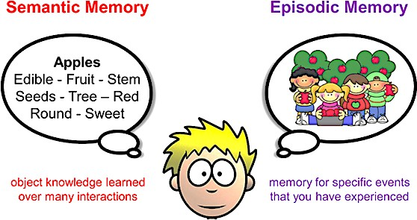
Type of Declarative Memory

Slide 21
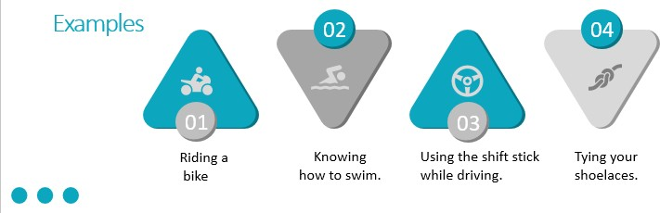
2. Non-Declarative Memory (Procedural Memory)
Memory that enables a person to perform specific learned skills or habitual responses.
Don’t have to consciously remember the steps involved in the actions to perform them.
Examples

Slide 22
Types of Long Term Memory
Declarative memory
memory with awareness.
information can be consciously recollected
Also known as Explicit memory
Non-Declarative memory/Procedural memory
memory without awareness.
Memory that affects behavior but cannot consciously be recalled
Also known as Implicit memory

Slide 23
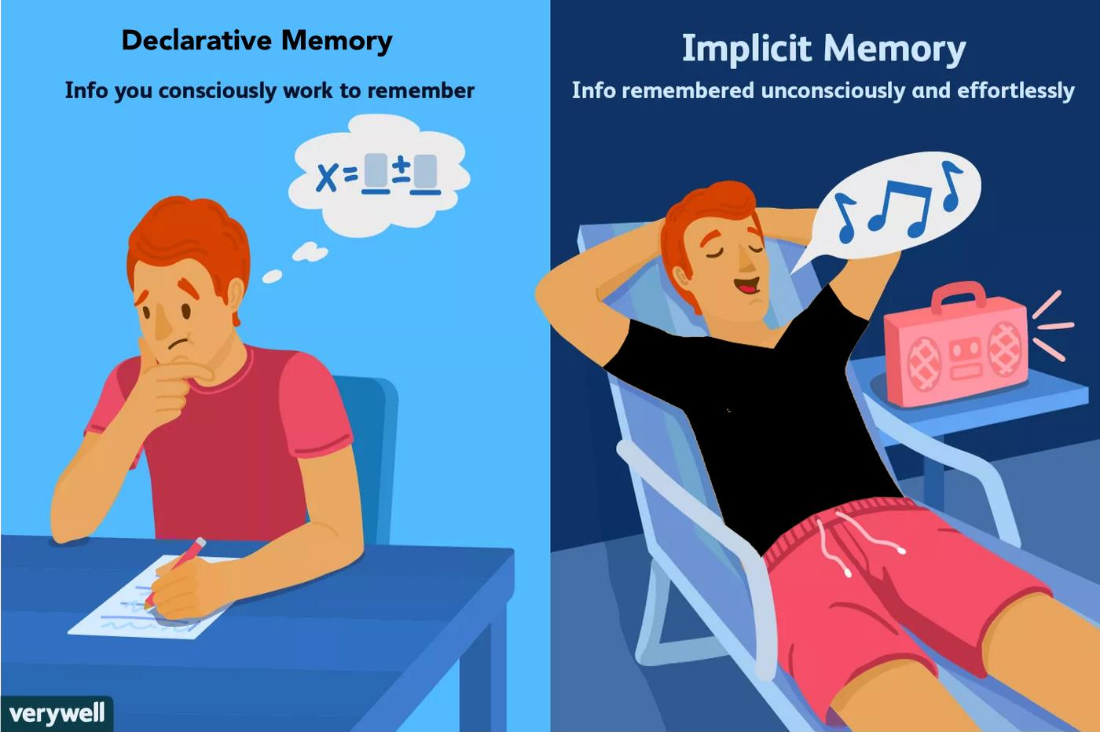


Slide 24





Ways to Improve Memory
Knowledge of Results
Feedback allowing you to check your progress
Recitation
Summarizing aloud while you are rehearsing material
Rehearsal
Reviewing information mentally (silently)
Elaborative Rehearsal
Looks for connections to existing knowledge
Selection
Selecting most important concepts to memorize
Organization
Organizing difficult items into chunks; a type of reordering

Slide 25
Thank you!

